Slide 1












Who Is
DESCO INDUSTRIES INC?
© 2022 DESCO INDUSTRIES INC
Employee Owned

Slide 2

Outline
Corporate Brands
Annual Revenue
History of DESCO INDUSTRIES INC
Acquisitions
Sales & Distribution Structure
Locations
Product Lines
Market
Strategic Issues in Sales & Marketing
DescoIndustries.com

Slide 3








DESCO INDUSTRIES INC
Full Service ESD Solutions and Packaging
Full Service ESD Solutions
ESD Process Control Solutions
European Full Service ESD Solutions
Specialty Tools
Material and Accessories for Electronics Business
Precision Hand Cutting Tools and Pliers, Wire Strippers and Tweezers
Hand Tools
ESD Packaging Solutions
Asian Sell Focus
ESD Flooring Solutions
Clean Room Assembly and Packaging
AC and DC Fans and Blowers and Related Accessories
Rework and Fume Extraction Solutions

Slide 4
Net Sales - Brand % Pie
STATGUARD FLOORING
1.7%
SPECIALTEAM
1.6%
DESCO Asia
5%
APR
1.1%
Protektive Pak
4.9%
Desco Europe
7.4%
SCS
41.5%
MENDA
8.4%
DESCO
29%
DescoIndustries.com

Slide 5

Annual Revenue - 2021
$73,400,000
DescoIndustries.com

Slide 6

Historical Overview
Desco Industries Incorporated in 1979. Company is 43 years old.
Started as a specialty tools manufacturer
Specialized in circuit tracers and solder aids
Background in distribution set the initial strategy
Desco launches distribution strategy
Desco hires first reps
DescoIndustries.com

Slide 7
Opportunity Knocks
1982 - Desco starts manufacturing static control products - private label
1984 - Desco enters static control market with wrist straps and ground cords
1985 - Desco adds matting products
Static control becomes primary revenue generator
DescoIndustries.com

Slide 8

Pieces Fall Into Place
DESCO INDUSTRIES INC begins roll-up strategy in static control market place
1988 - Control Static - Ionization, Test Equipment
1990 - Charleswater - Packaging, Floor Finish, Foot Grounders
1995 - Plastic Systems - Complementary direct sales channel
DescoIndustries.com

Slide 9
Acquisitions
1998: Conductive Products - European distribution/sales
1999: Wescorp - ESD Tape line
1999: Pilgrim - Continuous monitor/tester offering
2000: MENDA - Specialty Tools brand/platform
2002: Protektive Pak - ESD and Electronics Packaging
2003: Semtronics - High Electronics
2004: SPI - Room Ionization Process Ionization, new customer base
2007: Vermason – Expand European presence & market share
2008: CVinyl – RF Sealing of custom vinyl products
2013: SpecialTeam Medical Services – Contract assembly and packaging facility that provides expertise in cleanroom processing and manufacturing systems.
DescoIndustries.com

Slide 10
Acquisitions
2015: SCS - assets of 3M’s Static Control business
2017: EasyBraid – Equipment used in the PCB assembly industry
2018: US Toyo Fan – AC and DC fans and blowers and related accessories, such as finger guards, filters, and fan cords
2018: APR – Convection rework machines used to remove and install complex surface mounted devices
2019: Tronex - Precision hand cutting tools and pliers preferred by users in sectors including electronics manufacturing, medical device manufacturing and jewelry making.
2021: Beau Tech - Hand tools relating to the repair, rework, R&D, testing and assembly of electronic components and printed circuit boards.
DII steps up its drive to buy market share and expand its solutions/offering and customer base.

Slide 11

Recent Acquisitions
Desco Industries Inc acquired the product line from OK International / Metcal in January 2018. APR offers a product line of convection rework machines used to remove and install complex surface mounted devices such as BGA, CGA and QFN. APR machine models include the Scorpion, Scarab and APR-5000 series. All APR products are manufactured in Chino, CA.
On July 15, 2019 Desco Industries Inc of Chino, California has acquired the assets of Tronex Technology Inc. Tronex Technology, Inc is a designer and manufacturer of precision hand cutting tools and pliers, in addition to offering wire strippers and tweezers. Tronex precision hand tools are now preferred by users in sectors including electronics manufacturing, medical device manufacturing and jewelry making.
Beau Tech, acquired in 2021 and offered under the MENDA brand, is a US hand tools manufacturer that provides quality tools including MilProbes, Soldering Aids and Spudgers for applications relating to the repair, rework, R&D, testing and assembly of electronic components and printed circuit boards.
DescoIndustries.com

Slide 12
Organization
DII
Desco
Distribution
(ESD Focus)
SCS
Distribution
(ESD/Packaging)
Desco Europe
European
Distribution
(ESD Focus)
MENDA/
EasyBraid/
Tronex/
Beau Tech
Distribution
(Diversification)
Protektive Pak
Packaging
Channel
SpecialTeam
Cleanroom
Assembly
and
Packaging
Desco Asia
Asia
Distribution
Statguard
Flooring
Flooring
Dealers
(ESD Flooring
Solutions)
APR
Rework and
Fume
Extraction
DescoIndustries.com

Slide 13
Executive Management
John Brake - CEO
Jeffry Brake
Executive VP
Darryl Allen
Executive VP
Carlos De La Isla
VP Sales
David Maerzke
VP Operations
Sandy Staup
VP
Administration
Mark Hempel
VP Finance
Ted Krueger
VP Purchasing
Cheryl Uresti
VP Marketing
DescoIndustries.com

Slide 14
Sales & Marketing Managers
Cheryl Uresti
VP Marketing
Carlos De La Isla
VP Sales
Matt Hempel
Corporate Marketing
Olivia Berwick
Corporate Marketing
Mike Horngren
Corporate Marketing
Henry Salgado
Sales Manager
SCS
Gregg Heckler
Sales Manager
Desco
Steve Ngah
Sales Manager
Desco
Ganesh Sah
Corporate Marketing
Ryan Lee
Corporate Marketing
Adam Bernstein
Corporate Marketing
Christine Bennis
Packaging Sales Manager
SCS
Vaughan Callan
Sales Manager
Desco Europe
Cheryl Uresti
Brand Manager
SCS
Jeffry Brake
Brand Manager
Desco
Jeffry Brake
Brand Manager
Desco Asia
Alyssa Shaw
Brand Manager
Menda
Norma Nahale
Brand Manager
Protektive Pak
Matt Bode
Brand Manager
Desco Asia
Steven Burns
Brand Manager
Desco Europe
Rob DaRosa
Brand Manager
Statguard Flooring
Cle Williams
Brand Manager
SpecialTeam
Todd Brake / Victor Arellano
Brand Managers
APR
DescoIndustries.com

Slide 15
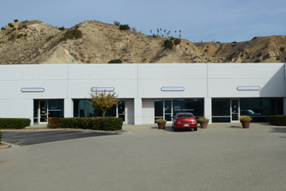
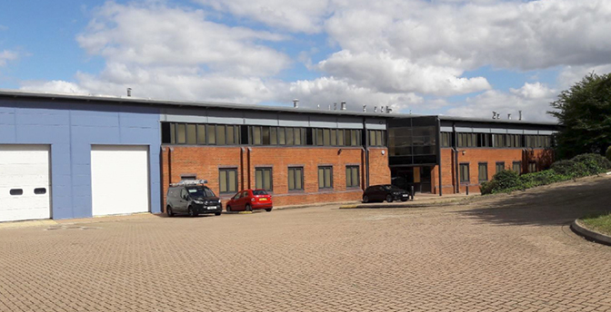
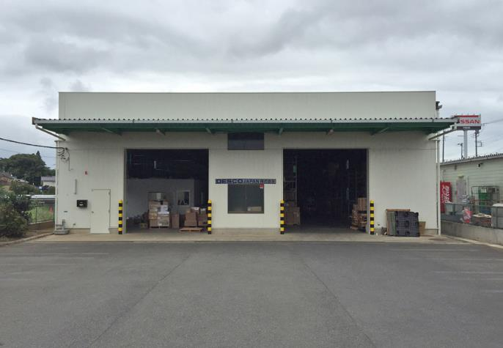
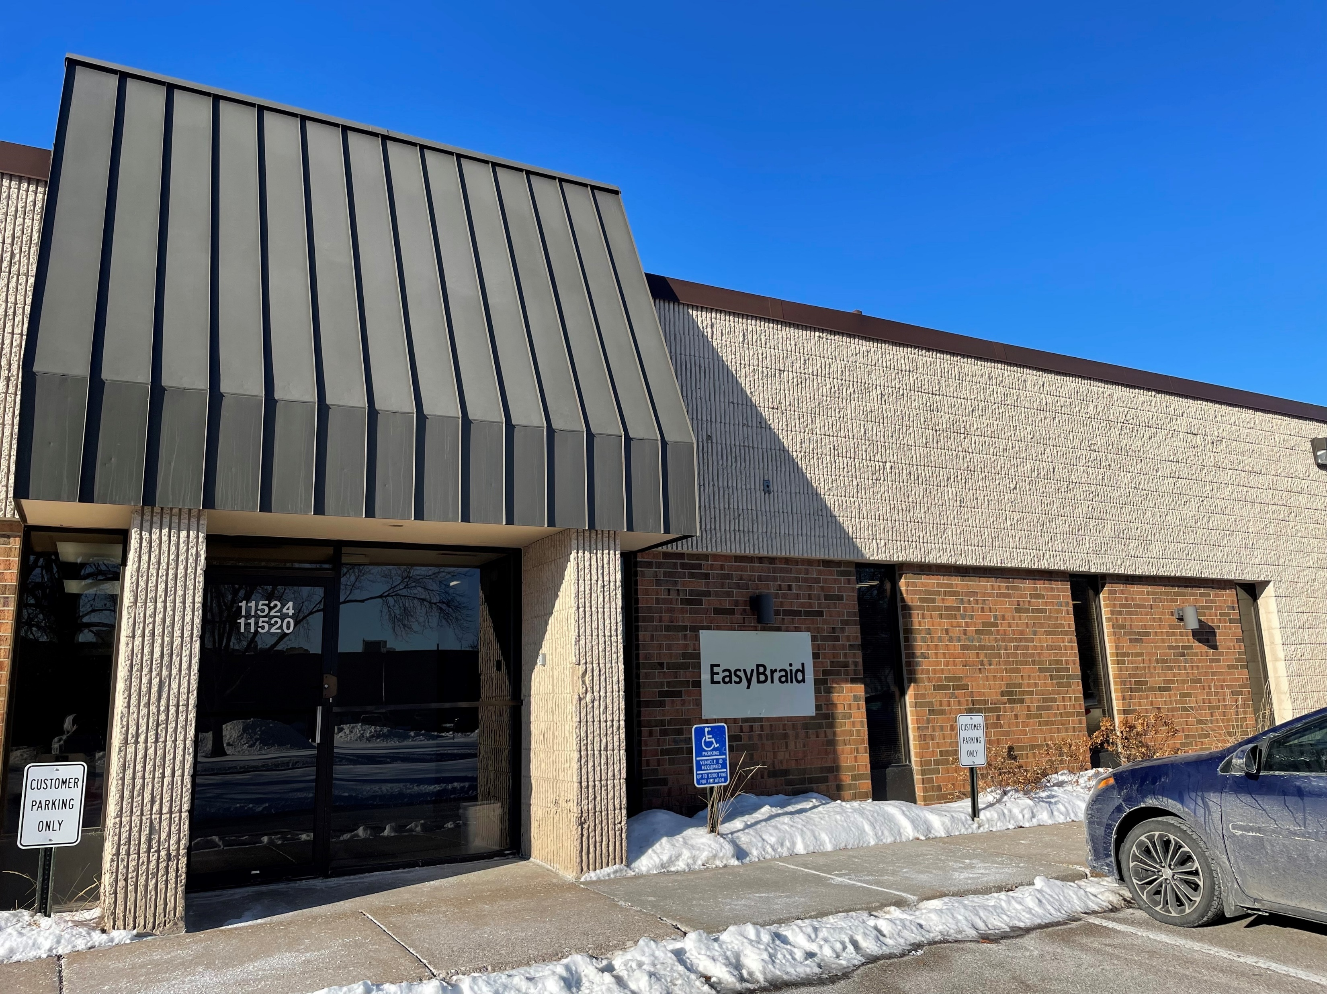
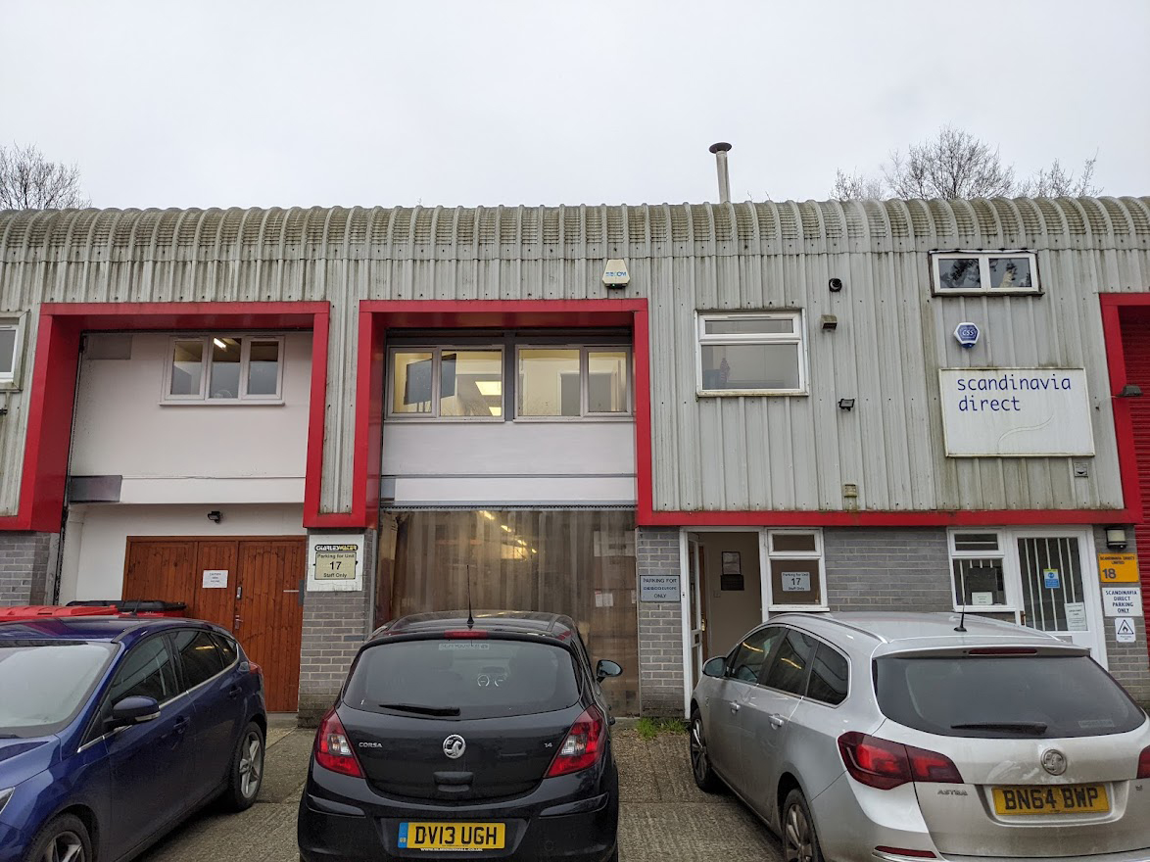
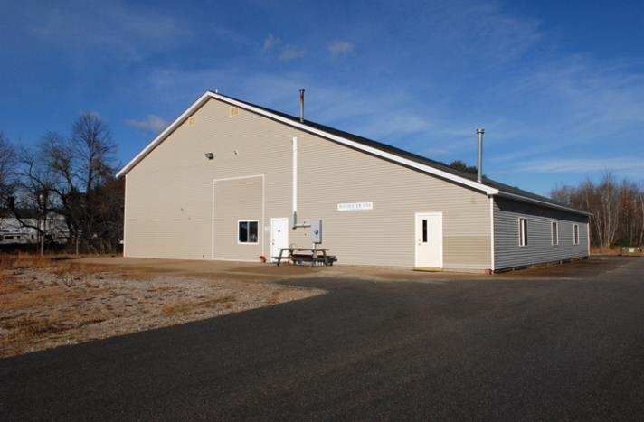
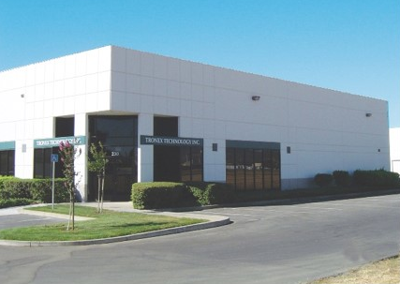
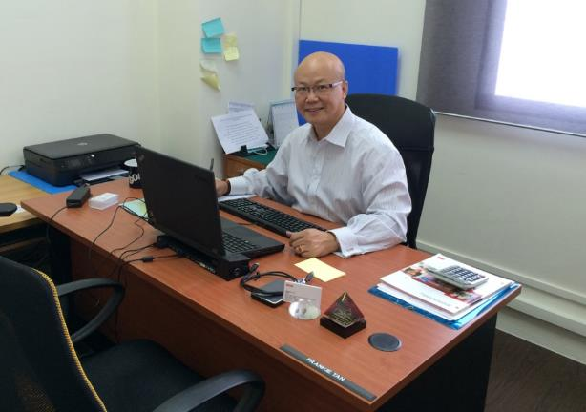
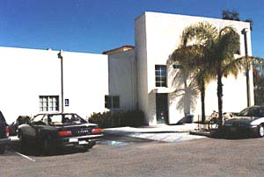
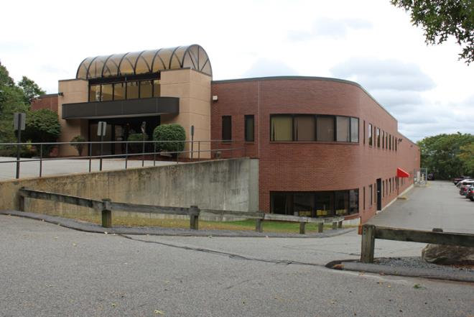
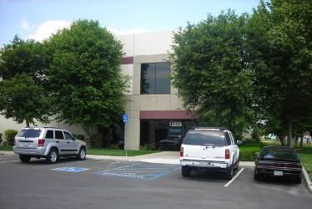
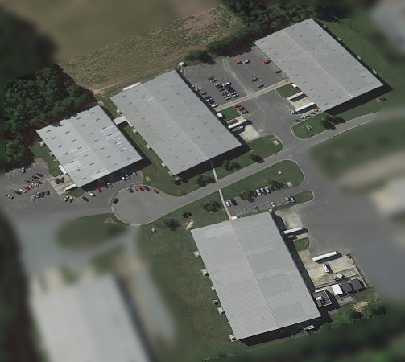
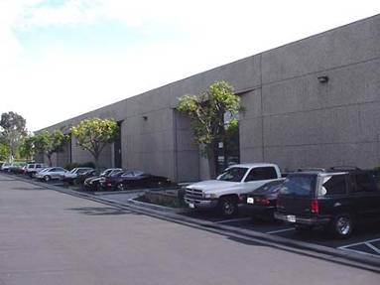
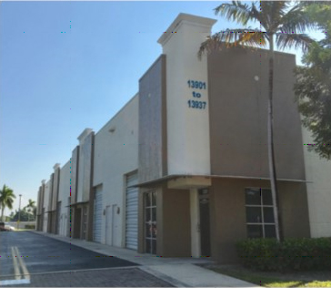
Locations
Minnetonka, MN
Letchworth, UK
Rochester, NH
Crowborough, UK
Fairfield, CA
Canton, MA
Santa Barbara, CA
Sanford, NC
Chino, CA
Yachimata City, Chiba, Japan
Yorba Linda, CA
Miami, FL
Singapore
DescoIndustries.com

Slide 16
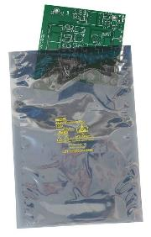
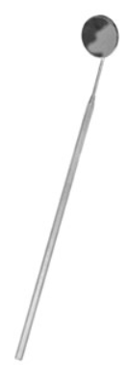
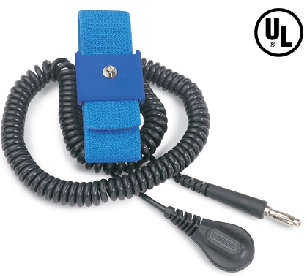
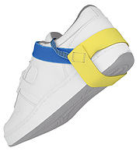
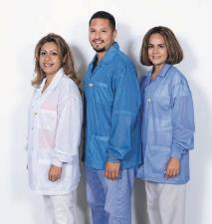
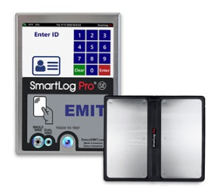
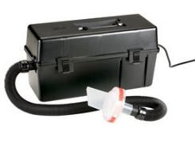
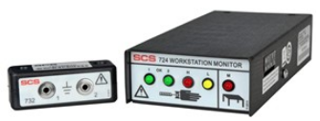
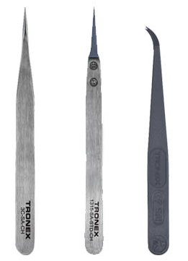
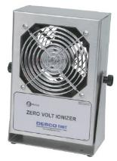

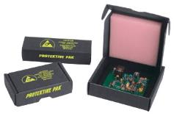
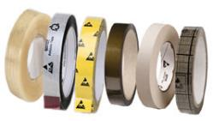

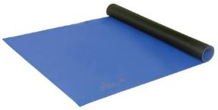
DESCO INDUSTRIES INC
Broadest Offering of ESD Control Solutions
DescoIndustries.com

Slide 17

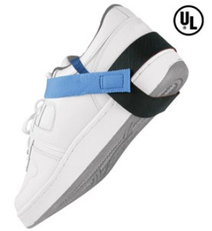
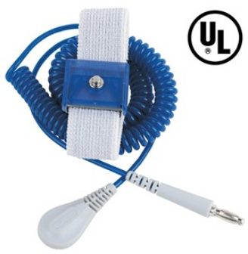
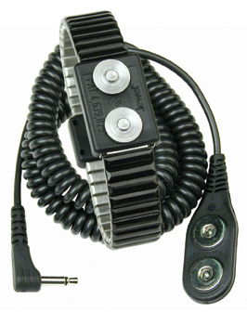
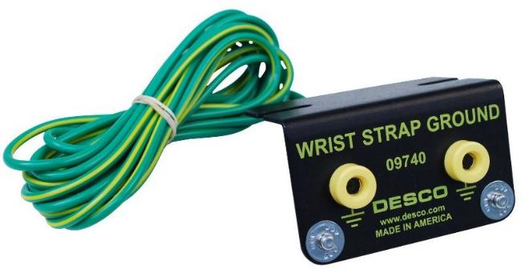

Broadest ESD Offering
Personnel Grounding - Wrist Straps, Foot Grounders, Ground Cords, multiple variations
Made in the United States of America
DescoIndustries.com

Slide 18
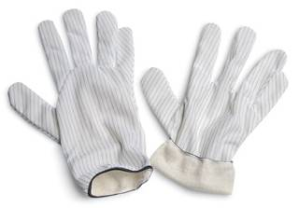
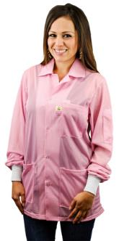
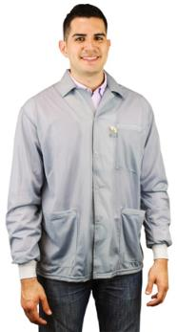
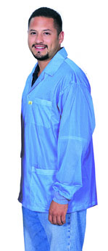
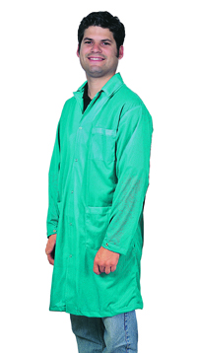
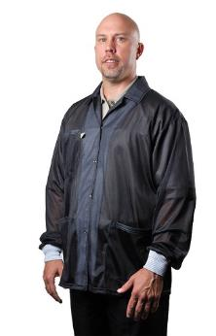
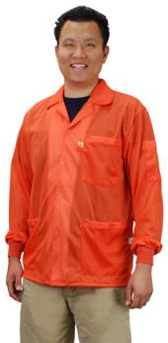
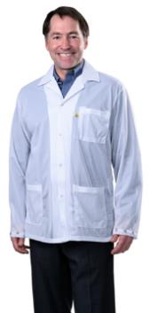
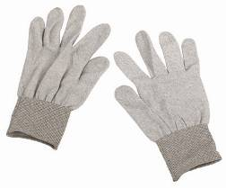
Broadest ESD Offering
Garments - Smocks, Gloves
Made in the United States of America
DescoIndustries.com

Slide 19
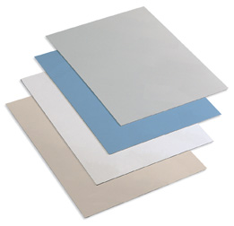
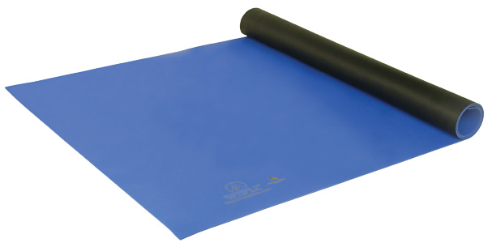
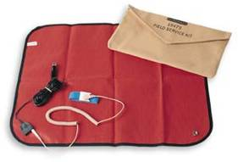
Broadest ESD Offering
Worksurfaces - 2-layer Rubber, Homogeneous Vinyl, 3-Layer Vinyl, Field Service Kits, Micastat Laminate
Made in the United States of America
DescoIndustries.com

Slide 20
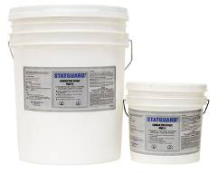
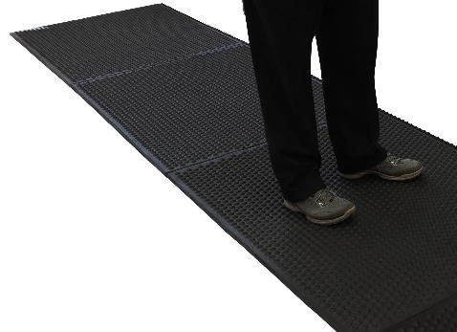
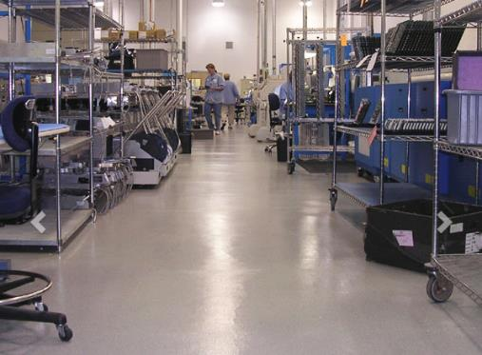
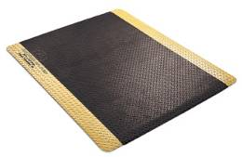
Broadest ESD Offering
ESD Flooring - Rolled Matting, Modular Anti-Fatigue, Floor Finish, Conductive Paint, Epoxy, Carpet Spray, VCT, Carpet, Rubber Tiles
Made in the United States of America
DescoIndustries.com

Slide 21
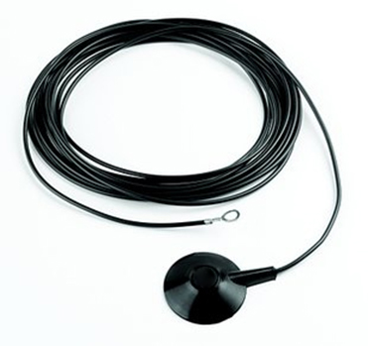
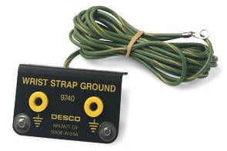
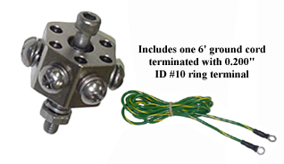
Broadest ESD Offering
Grounding Accessories & Tools
Made in the United States of America
DescoIndustries.com

Slide 22








Broadest ESD Offering
Test Equipment – ESD Event Meter, Continuous Monitors, Personnel Grounding Testers, Surface Resistance Testers, Calibration & Verification.
Made in the United States of America
DescoIndustries.com

Slide 23



Broadest ESD Offering
Data Acquisition – SmartLog Pro® (verifies the functionality of an operator’s wrist strap and footwear, logs the test results, and controls access to an ESD Protected Area) and SMP (continuously monitors ESD process control system throughout all stages of manufacturing)
Made in the United States of America
DescoIndustries.com

Slide 24







Broadest ESD Offering
Ionization - Overhead, Benchtop, Compressed air, Process Ionization, Room Ionization
Made in the United States of America
DescoIndustries.com

Slide 25





Broadest ESD Offering
Packaging, Coating, and Laminating - Static Shielding (including qualified to Mil-PRF-81705E Type III, Class 2), Moisture-Vapor-Barrier, Clear dissipative, Unique Bag-In-Bag, Bags on roll, Vacuum Sealers
Made in the United States of America
DescoIndustries.com

Slide 26








Broadest ESD Offering
Packaging - Protektive Pak packaging provides complete ESD and physical protection for static sensitive devices
Made in the United States of America
DescoIndustries.com

Slide 27




Broadest ESD Offering
ESD Tapes and Labels - Clear, Conductive Grid, Masking, Kapton, floor marking, Green labels
DescoIndustries.com

Slide 28








Broadest Offering
Specialty Products - Dispensers, Brushes, Portable Workstation Organizer, ESD Lotion, ESD Vacuum
DescoIndustries.com

Slide 29



Broadest Offering
Specialty Tools – Stainless Steel Probes, Spudgers Cable Ties, Sleeving Cutter, Wire Threader, Cleaning Brushes, Soldering Aids
Made in the United States of America
DescoIndustries.com

Slide 30



Broadest Offering
Specialty Products - Soldering Stations and Equipment: Desoldering Braid, Stencil Rolls and Wipes, Solder Soakers
DescoIndustries.com

Slide 31





Broadest Offering
Specialty Products – Hand tools: Cutters, Pliers, Strippers, Tweezers
DescoIndustries.com

Slide 32







Broadest Offering
Beauty Supplies – Pumps and Bottles, Aprons, Orange Sticks
DescoIndustries.com

Slide 33









Broadest Offering
Identification – Badge Holders, Badge Reels, Lanyards
Made in the United States of America
DescoIndustries.com

Slide 34






Broadest Offering
Thermal Management – AC and DC fans and blowers and related accessories, such as finger guards, filters, and fan cords
DescoIndustries.com

Slide 35



Broadest Offering
Contract Cleanroom Assembly and Packaging
ISO and FDA Registered Facility: ISO 13485:2016 | FDA Registered 2032092
DescoIndustries.com

Slide 36

In-House Training and
Customer Support
Factory Trained Technicians who can perform ESD training and support
Inside Sales team provides added support
NARTE Certified sales force
Product Management and marketing team provides additional expertise
DescoIndustries.com

Slide 37

Largest Manufacturer of ESD Products in the World
$73,400,000 in Revenues
USA Manufacturer with factories in Chino, CA;
Yorba Linda, CA; Santa Barbara, CA; Fairfield, CA; Canton, MA; Sanford, NC; Rochester, NH; Miami, FL; Minnetonka, MN; Letchworth, UK; Yachimata, Japan
World’s largest inventory of ESD Products: Chino, CA; Santa Barbara, CA; Canton, MA; Sanford, NC; Rochester, NH; Crowborough, UK; Letchworth, UK; Yachimata City, Chiba, Japan
Partnered with world class suppliers, including: Berry Plastics Corporation, Polyplex USA LLC, American Biltrite Ltd, Chemprene Inc, Pandel Inc, Simco Ion Technology Group, Metcal, etc.
Financial and Human Resource Support for Growth
DescoIndustries.com

Slide 38
DII Market Driven Strategies
Multiple channels to address fragmented
market place:
Full Service ESD Solutions provider - Primarily sell through distribution. Sales support includes manufacturers representatives and iNARTE Certified factory personnel
e-Comm driven - Broadens our reach to increase demand
European and Asian focus, support globalization of
customer base
Multiple brands allow for diversification outside our core market segment of electronics manufacturers.
DescoIndustries.com

Slide 39

Information Systems
15 e-Commerce sites: SCS, Desco, ESD Systems, MENDA, Desco Europe, Menda Beauty, Desco Asia, Desco Japan, EMIT, Statguard Flooring, Protektive Pak, APR, Tronex, EasyBraid and US Toyo Fan
Contact Management and ERP System
Web Sites with on-line catalogs in place for all brands
Other brands to expand use of e-Comm and web-sites as marketing tools
DescoIndustries.com

Slide 40

Marketing Focus
Driving traffic to our brand websites is our primary marketing focus
Create programs to increase direct end user communications
Distributor Portal for content and images
Promotion of brands, products and value added services
DescoIndustries.com

Slide 41

Value of the Brand
Establishes brand equity, adds value beyond the generic service or product benefit.
Makes an intangible product or service more tangible, allows differentiation.
Increases long-term sustainability. Any product can be copied, but a brand cannot.
DescoIndustries.com

Slide 42
Value of the Brand
Better corporate vision and mission. Provides clear principles to guide management decision.
Consistency - both internally and to customers.
Provides platform for future service or product developments.
DescoIndustries.com

Slide 43
Product Trademarks
Chargbuster®
Micastat®
Charge-Guard®
Razor Flush®
Dri-Shield®
SmartLog Pro®
durAstatic®
Statfree®
EasyBraid®
Statguard®
Iron Man®
Statshield®
Jewel®
Trustat®
Magsnap®
Velostat®
DescoIndustries.com

Slide 44


Product Brands
durAstatic®
DescoIndustries.com

Slide 45




Product Brands
Personnel and Mat Grounding, Test Equipment
Trustat™
Jewel®
ErgoBand®
Ion Pro™
SmartLog Pro®
DescoIndustries.com

Slide 46




Product Brands
Packaging & Personnel Grounding
Statshield®
Protektive Pak®
AutoShield™
Dri-Shield®
DescoIndustries.com

Slide 47

Product Brands
Production Tools
Circuitracer®
DescoIndustries.com

Slide 48


Web Sites
Desco
SCS
MENDA
MENDABeatuy
Protektive Pak
APR
Tronex
EASYBRAID
Desco Asia
Desco Japan
Desco Europe
Statguard Flooring
SpecialTeam
ESDSystems.com
USToyoFan
DescoIndustries.com

Slide 49

Web Site Features
e-Commerce shopping cart
24/7/365 service/support
On-line stock check and pricing
Online catalog
Guest Checkout
Responsive design
Listing of Reps & Distributors
New Products
Promotions
Package Tracking System
Technical Bulletins & Drawings
Newsletters / Training
DescoIndustries.com

Slide 50

Who Is Desco Industries
DescoIndustries.com

Slide 51

DII Family of Companies...
... is focused on growth, expansion, & profit!
DescoIndustries.com

Slide 52

The Sun Never Sets on
Desco Industries Inc

